Slide 1
Session 7 ANALYSIS OF VARIANCE

Slide 2
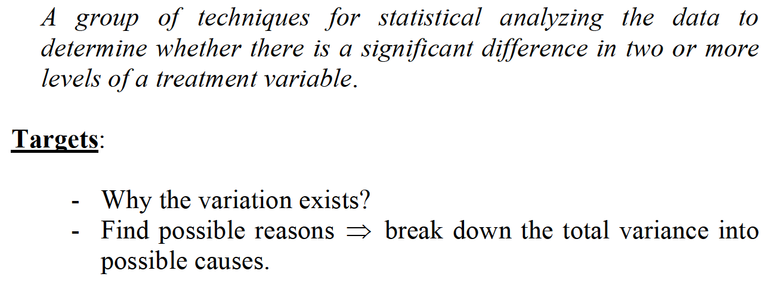
ONE-FACTOR ANALYSIS OF VARIANCE

Slide 3
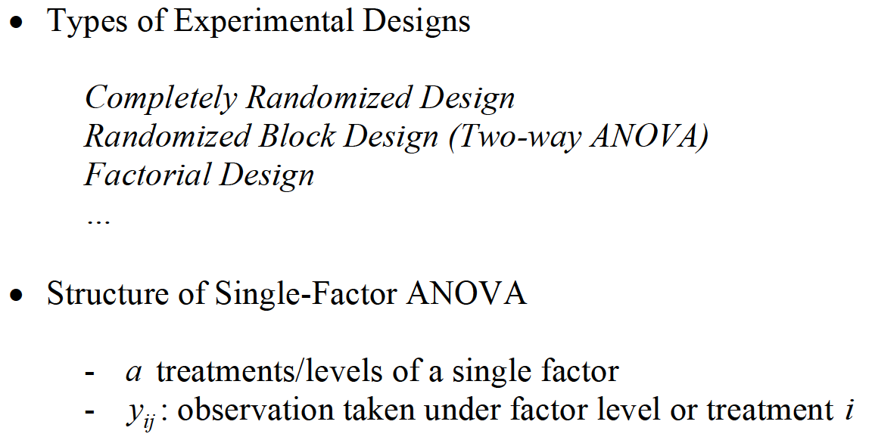
ONE-FACTOR ANALYSIS OF VARIANCE

Slide 4
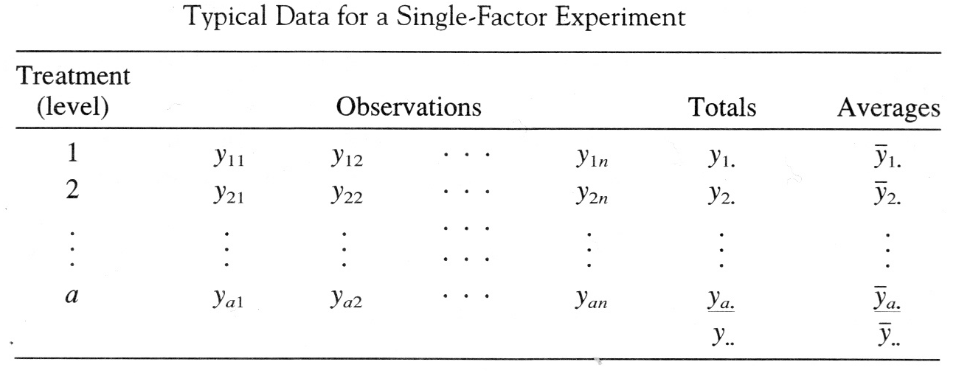
ONE-FACTOR ANALYSIS OF VARIANCE

Slide 5
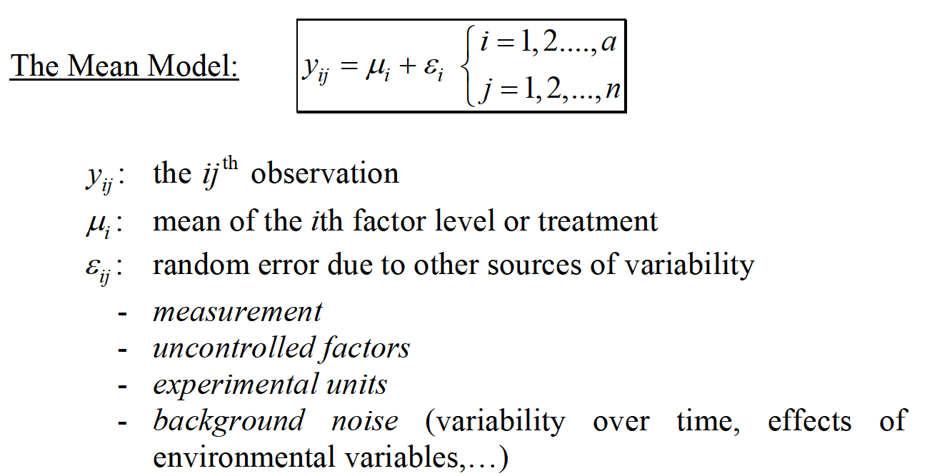
ONE-FACTOR ANALYSIS OF VARIANCE

Slide 6
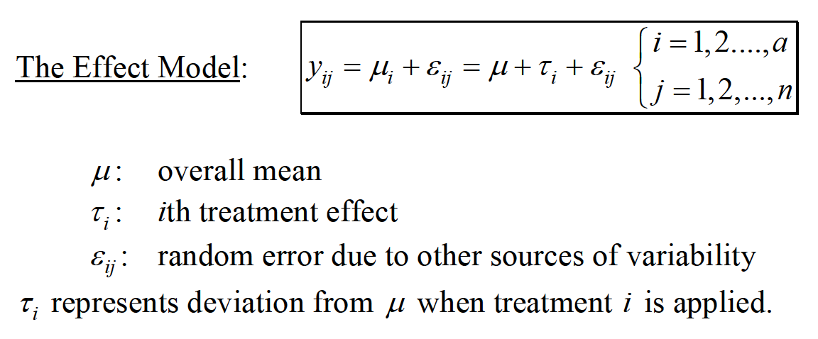
ONE-FACTOR ANALYSIS OF VARIANCE

Slide 7
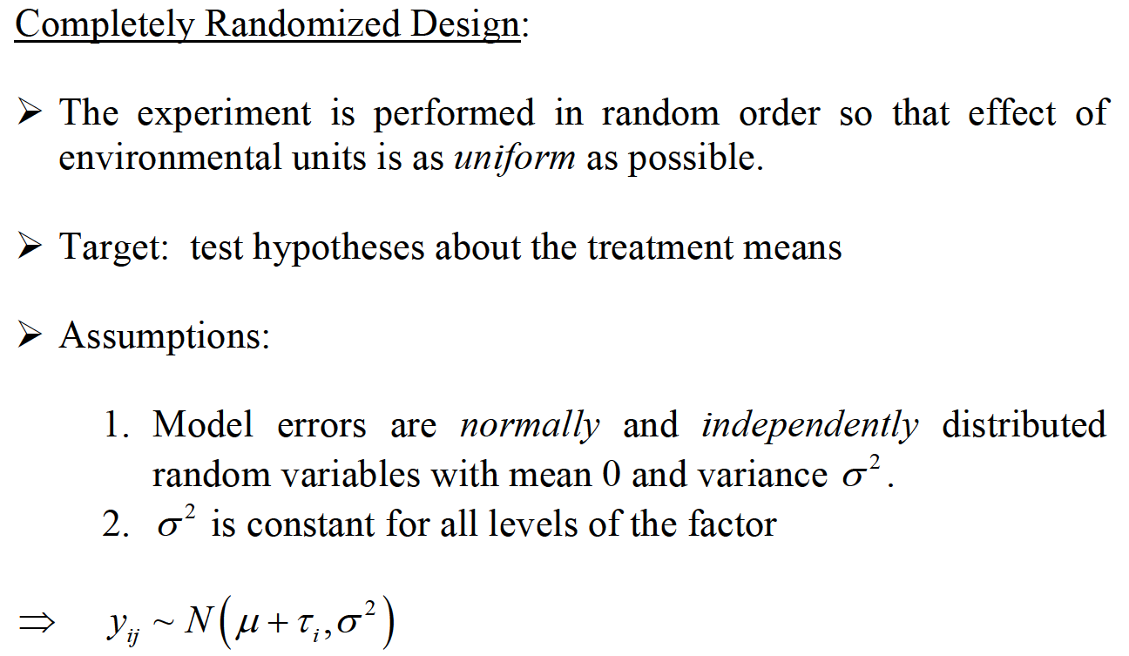
ONE-FACTOR ANALYSIS OF VARIANCE

Slide 8
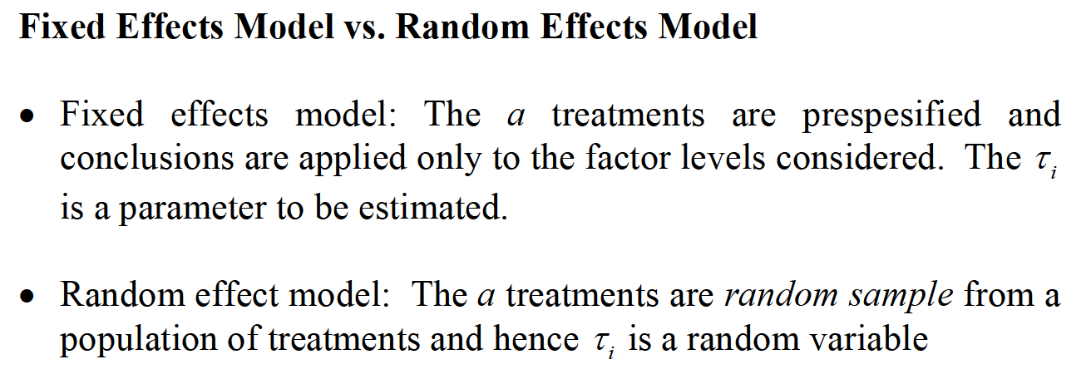
ONE-FACTOR ANALYSIS OF VARIANCE

Slide 9
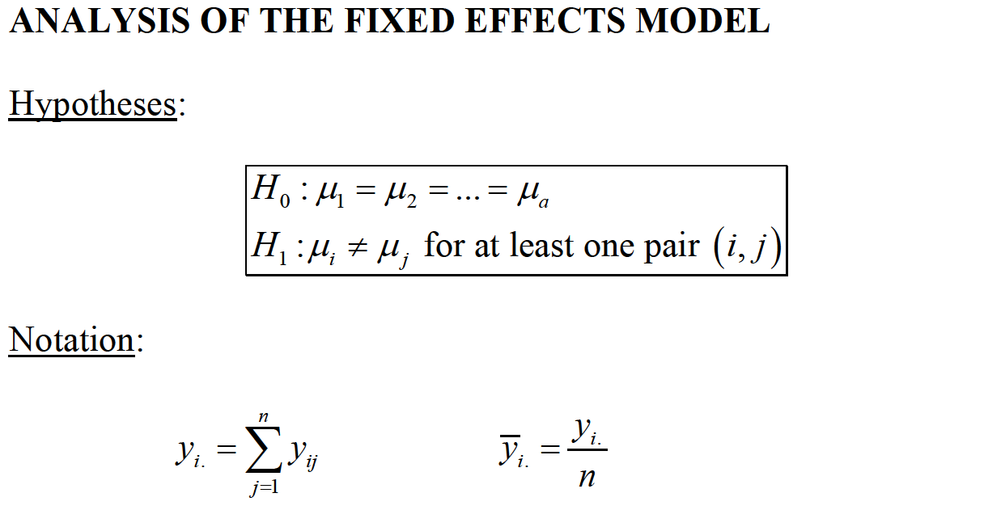

ONE-FACTOR ANALYSIS OF VARIANCE

Slide 10
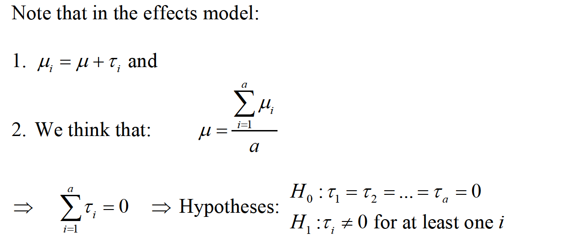
ONE-FACTOR ANALYSIS OF VARIANCE

Slide 11
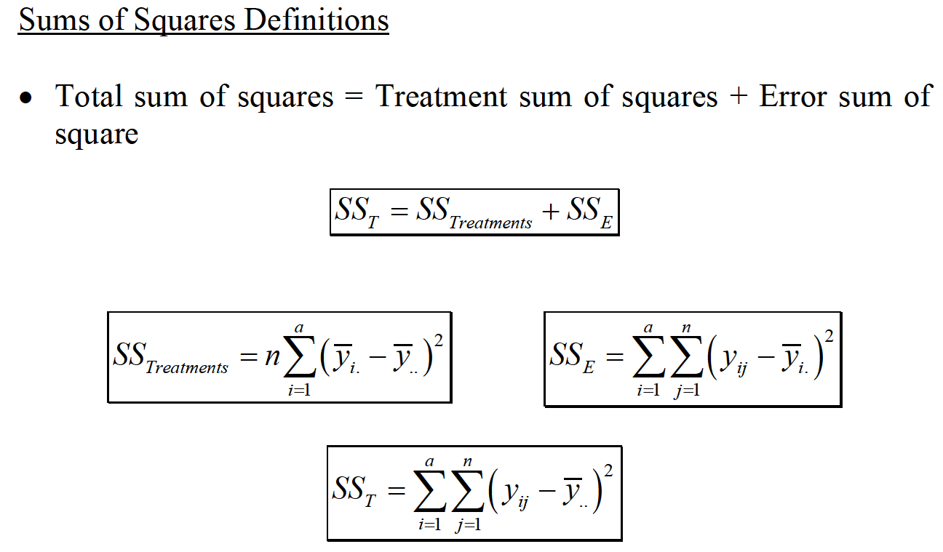
ONE-FACTOR ANALYSIS OF VARIANCE

Slide 12
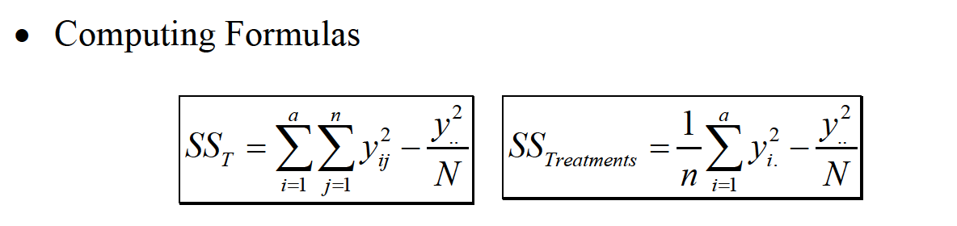
ONE-FACTOR ANALYSIS OF VARIANCE

Slide 13
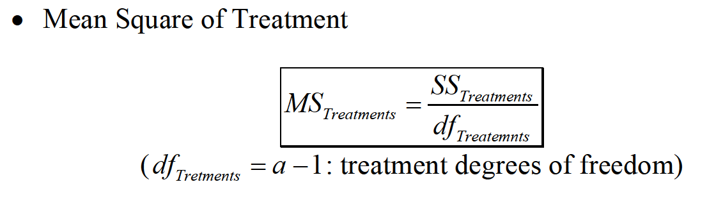
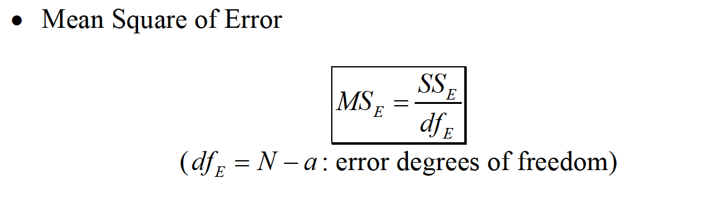
ONE-FACTOR ANALYSIS OF VARIANCE

Slide 14
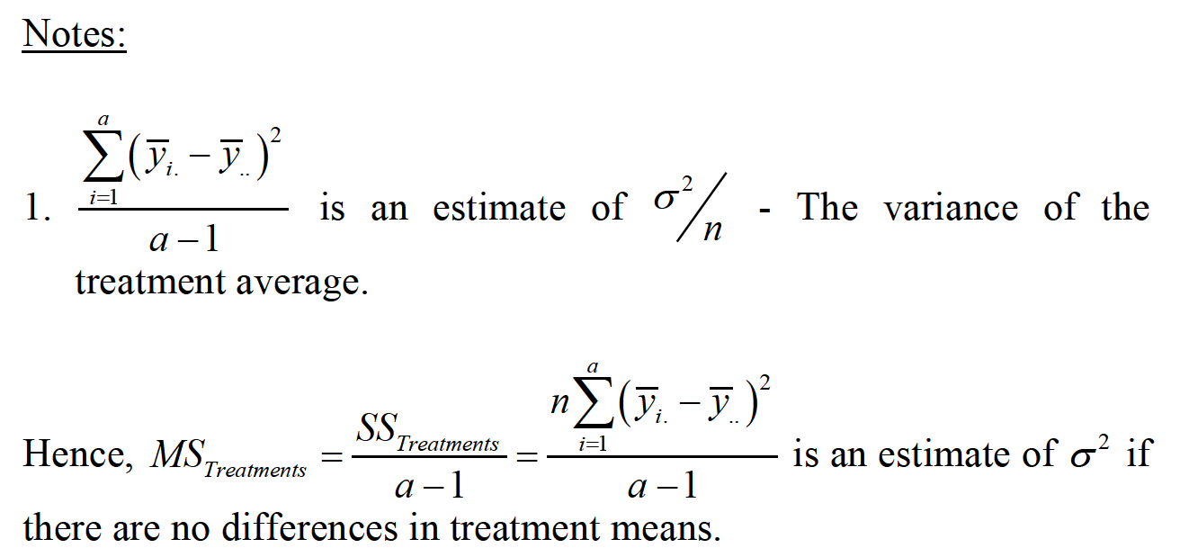
ONE-FACTOR ANALYSIS OF VARIANCE

Slide 15
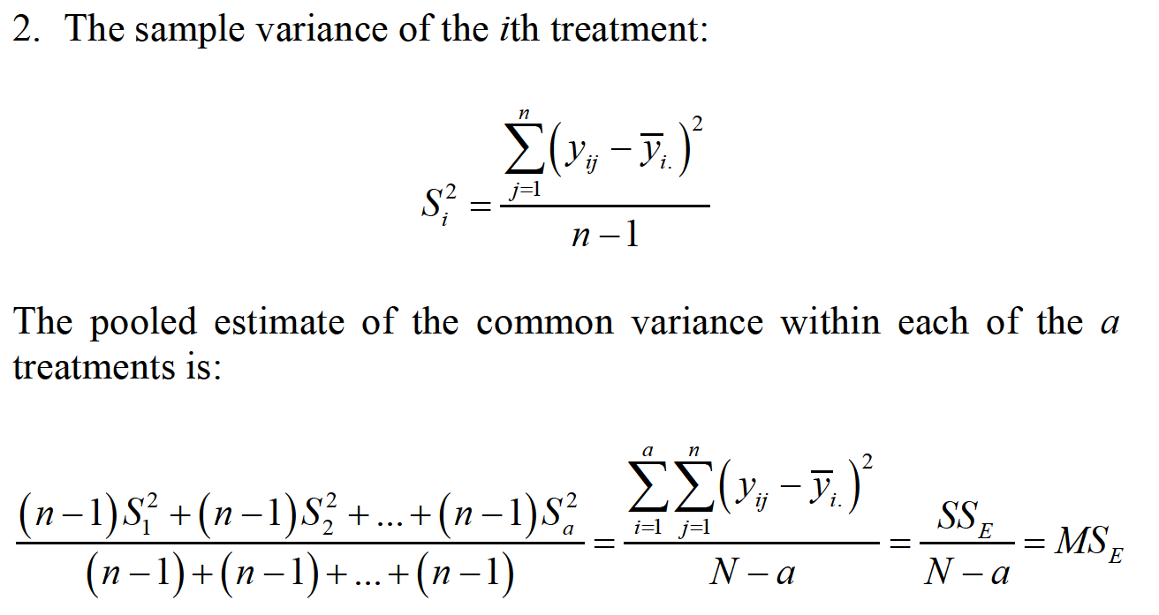
ONE-FACTOR ANALYSIS OF VARIANCE

Slide 16
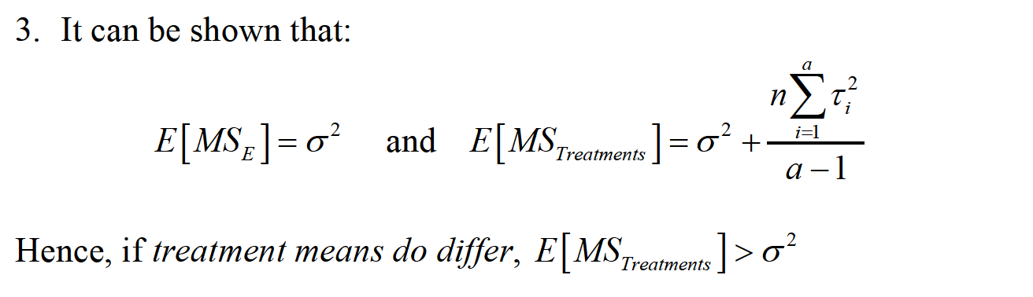
ONE-FACTOR ANALYSIS OF VARIANCE

Slide 17
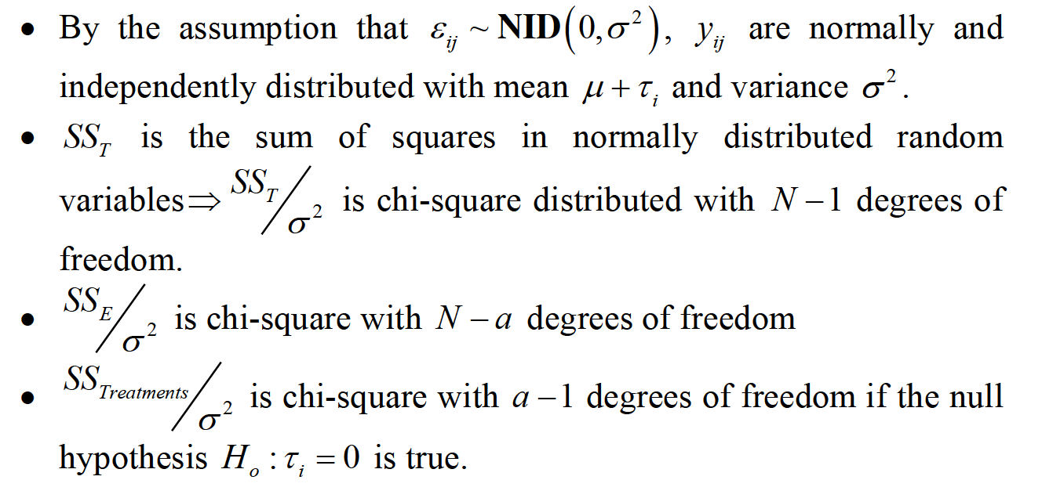
ONE-FACTOR ANALYSIS OF VARIANCE

Slide 18
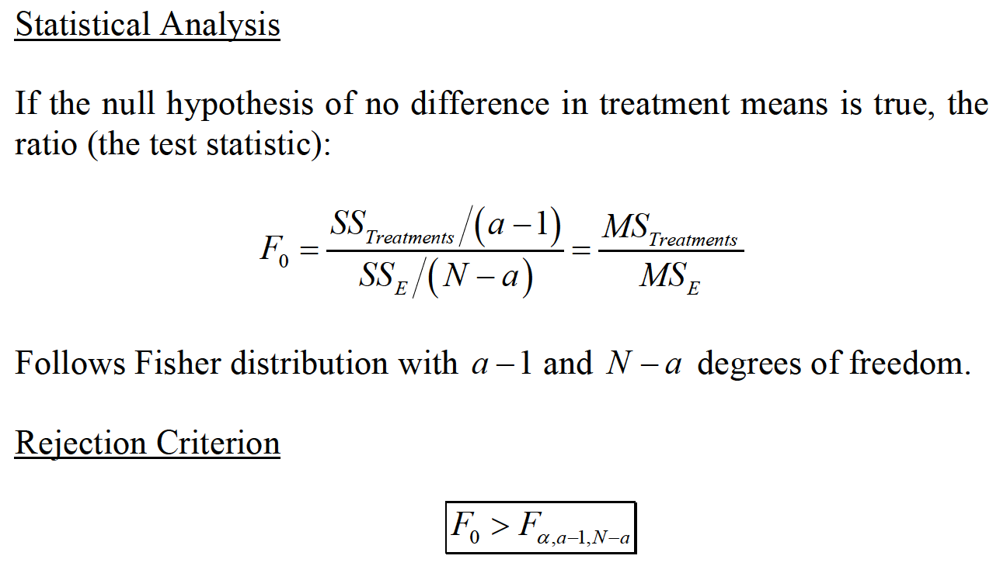
ONE-FACTOR ANALYSIS OF VARIANCE

Slide 19
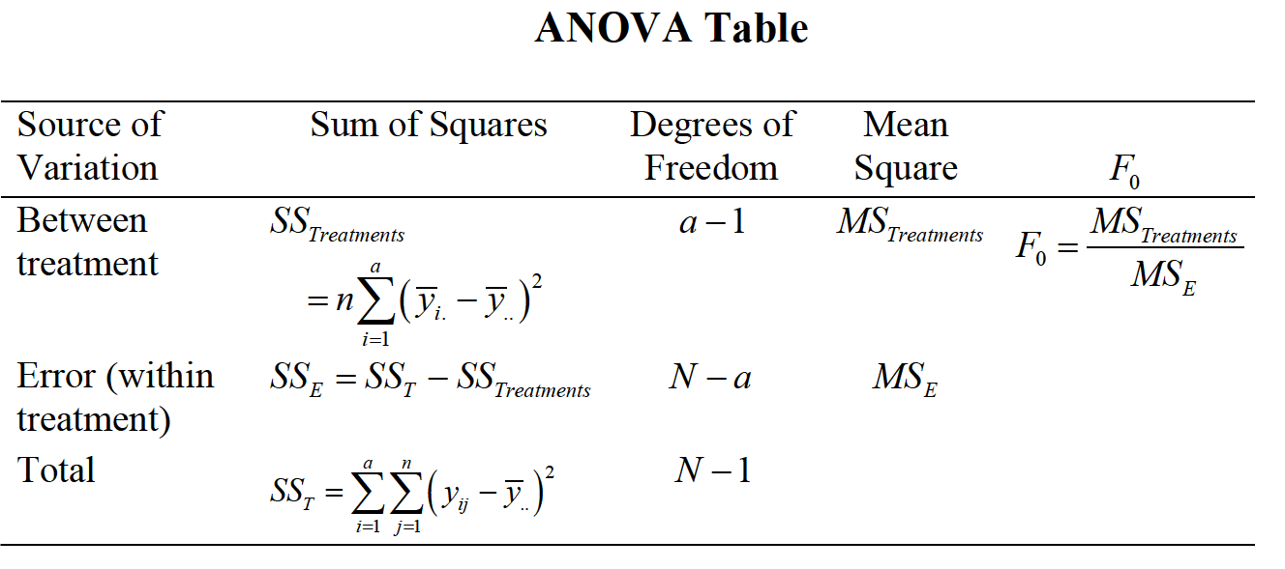
ONE-FACTOR ANALYSIS OF VARIANCE

Slide 20
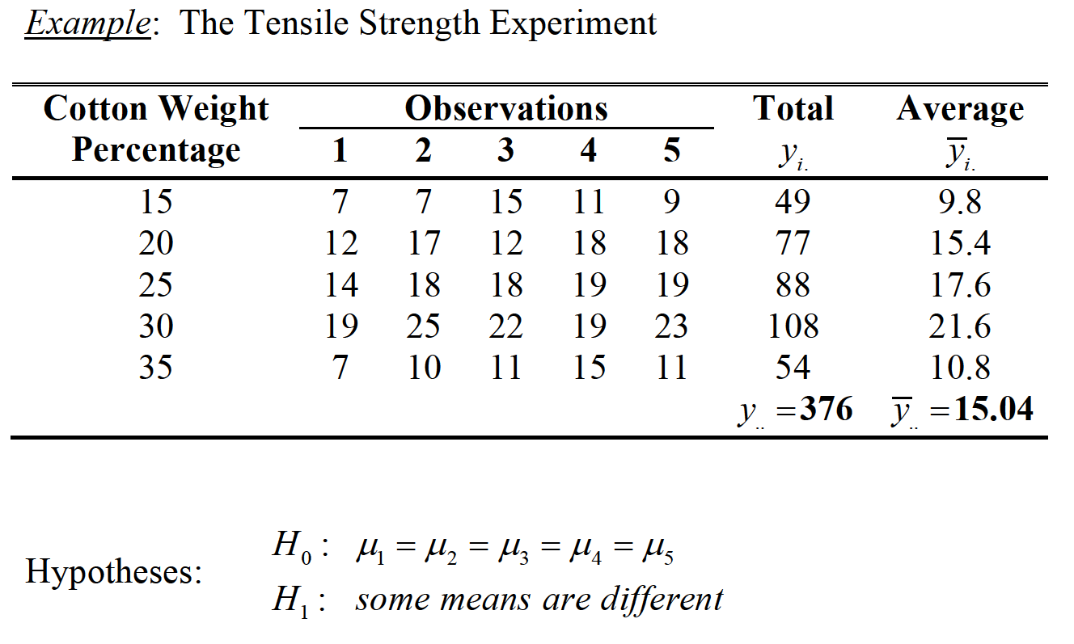
ONE-FACTOR ANALYSIS OF VARIANCE

Slide 21
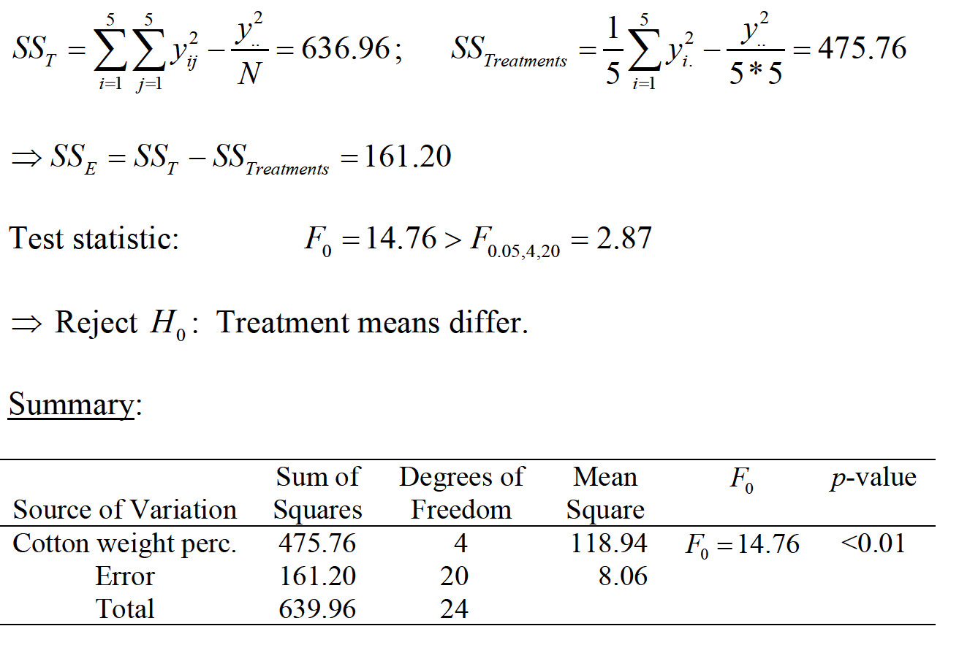
ONE-FACTOR ANALYSIS OF VARIANCE

Slide 22
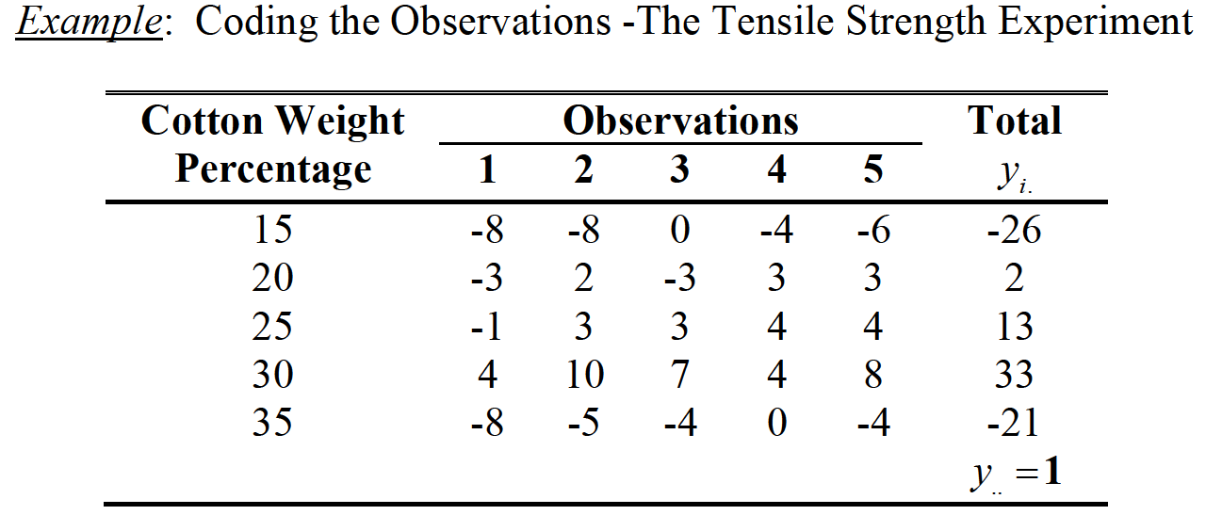
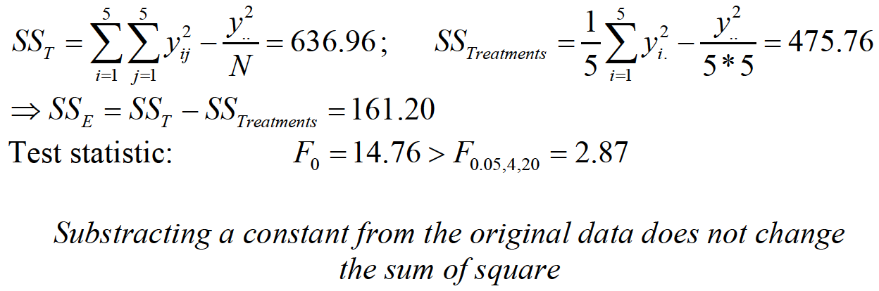
ONE-FACTOR ANALYSIS OF VARIANCE

Slide 23
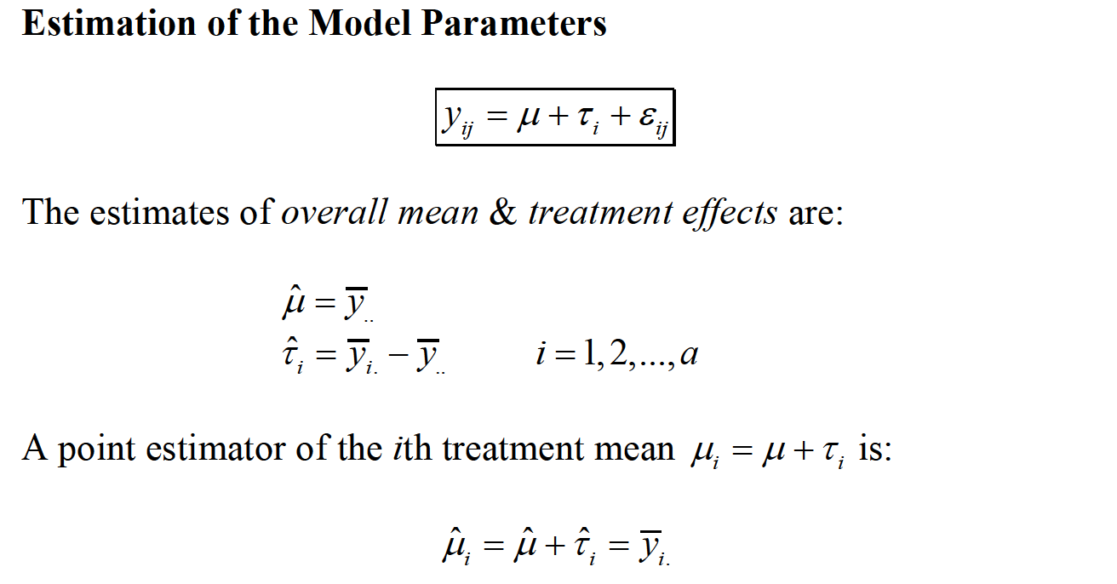
ONE-FACTOR ANALYSIS OF VARIANCE

Slide 24
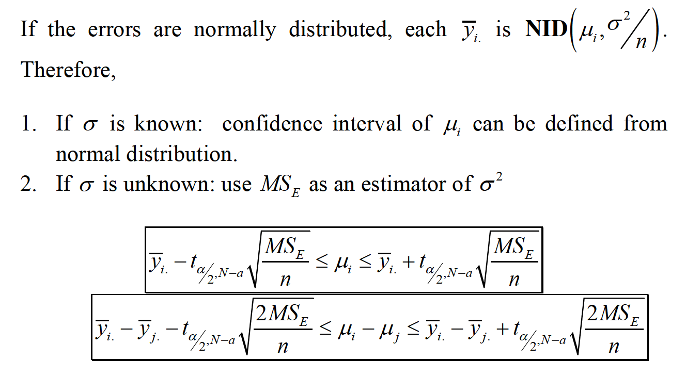
ONE-FACTOR ANALYSIS OF VARIANCE

Slide 25
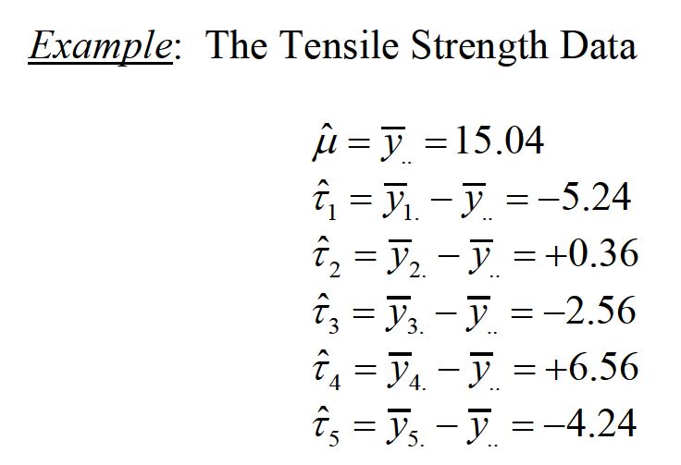
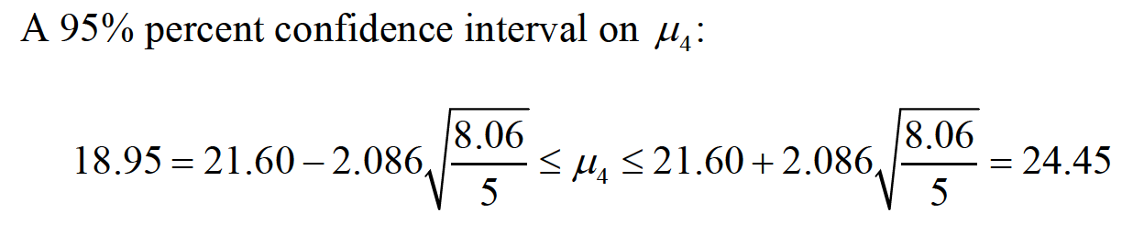
ONE-FACTOR ANALYSIS OF VARIANCE

Slide 26
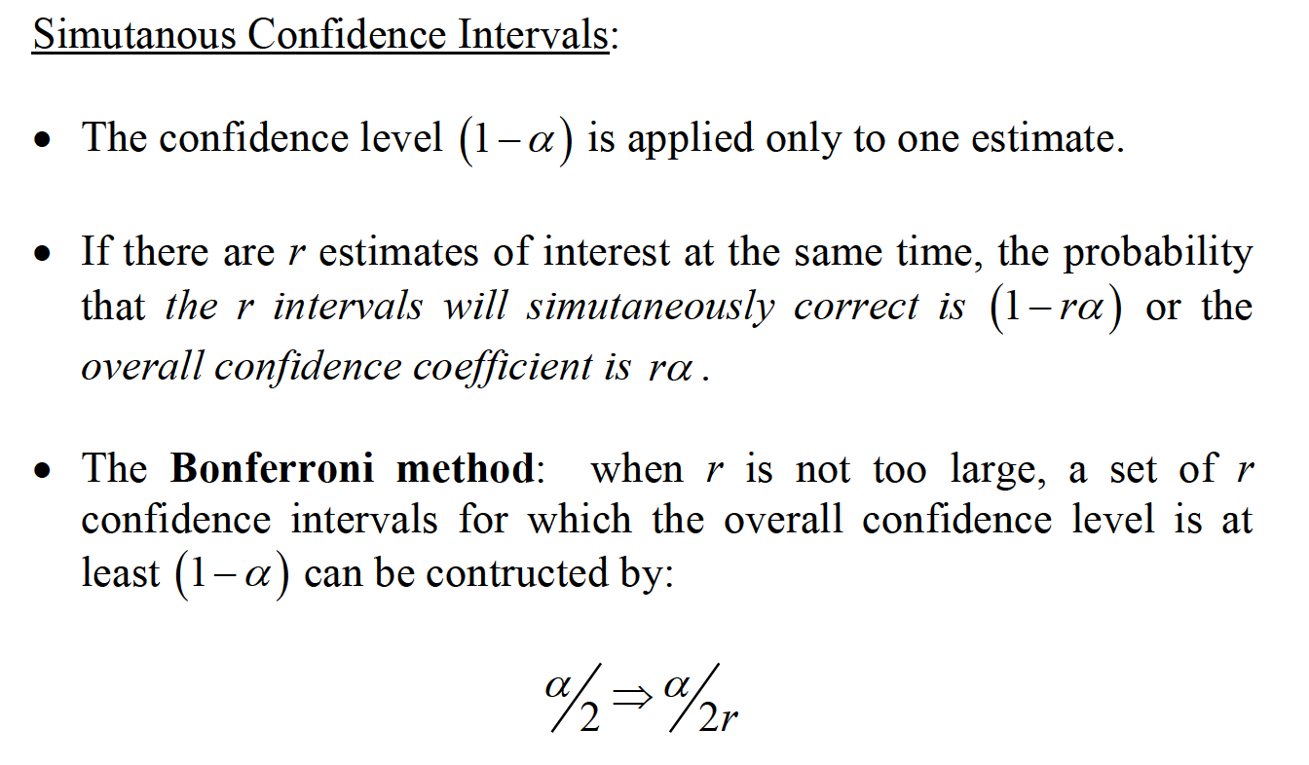
ONE-FACTOR ANALYSIS OF VARIANCE

Slide 27
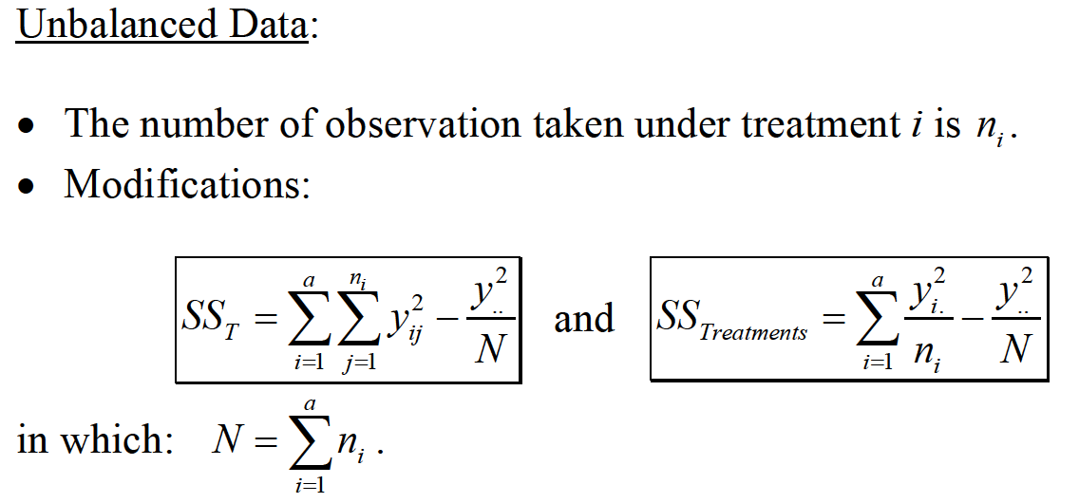
ONE-FACTOR ANALYSIS OF VARIANCE

Slide 28
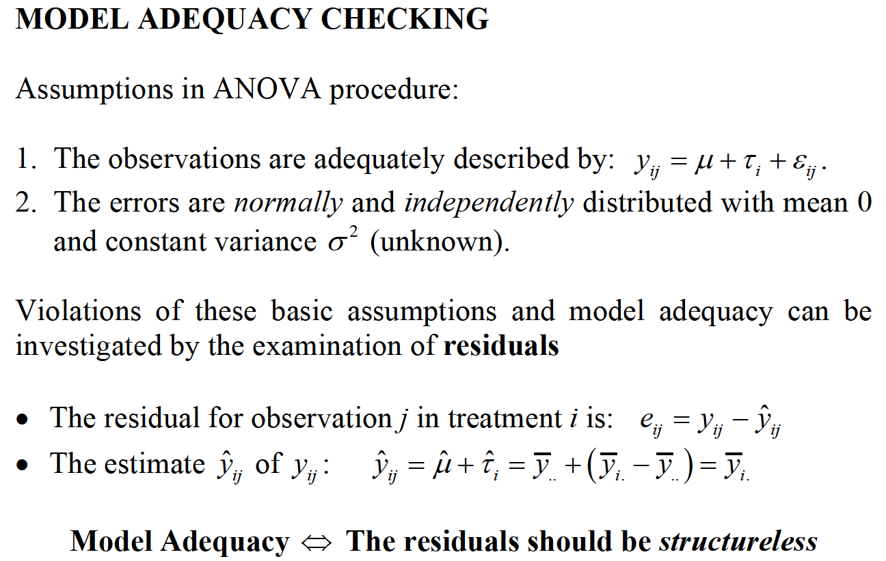
ONE-FACTOR ANALYSIS OF VARIANCE

Slide 29
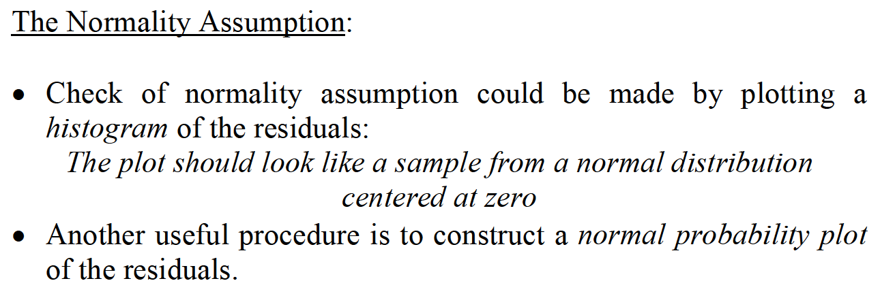
ONE-FACTOR ANALYSIS OF VARIANCE

Slide 30
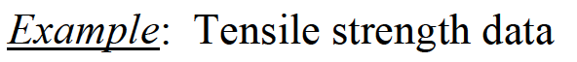
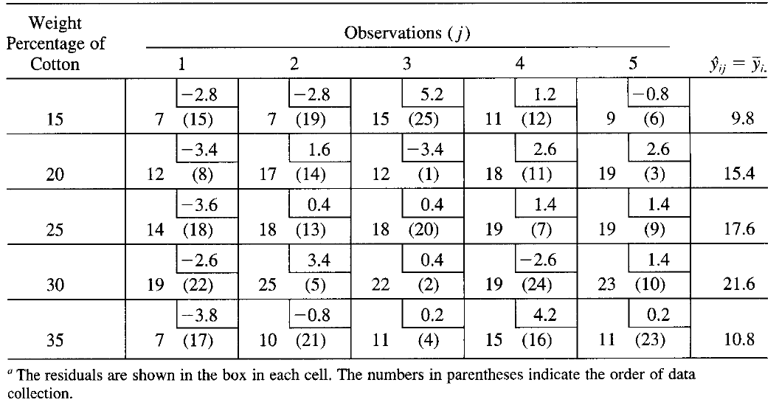
ONE-FACTOR ANALYSIS OF VARIANCE

Slide 31
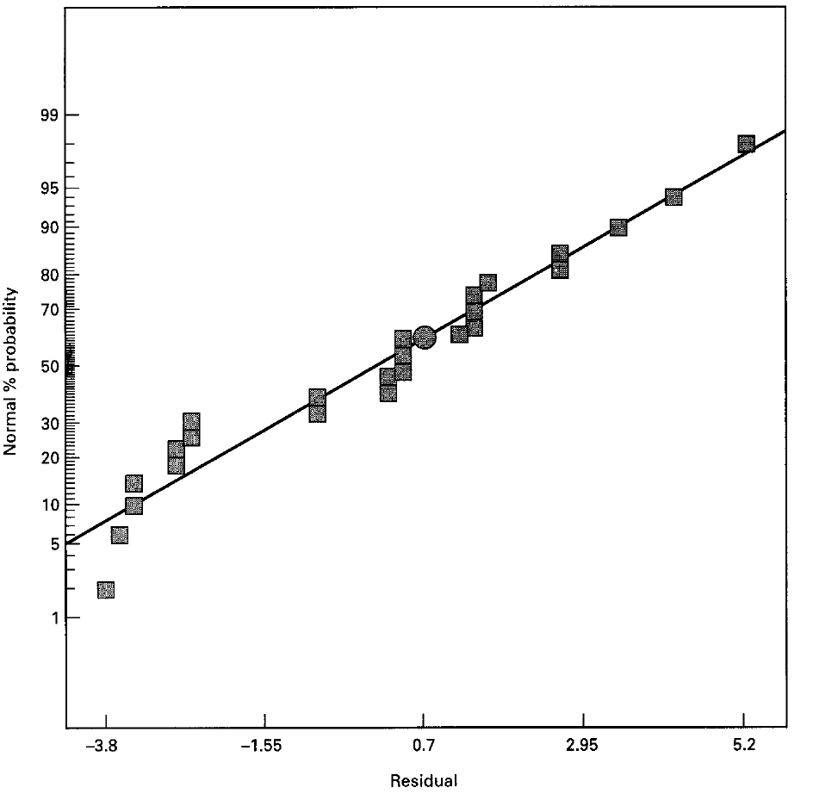
ONE-FACTOR ANALYSIS OF VARIANCE
Normal Probability Plot

Slide 32
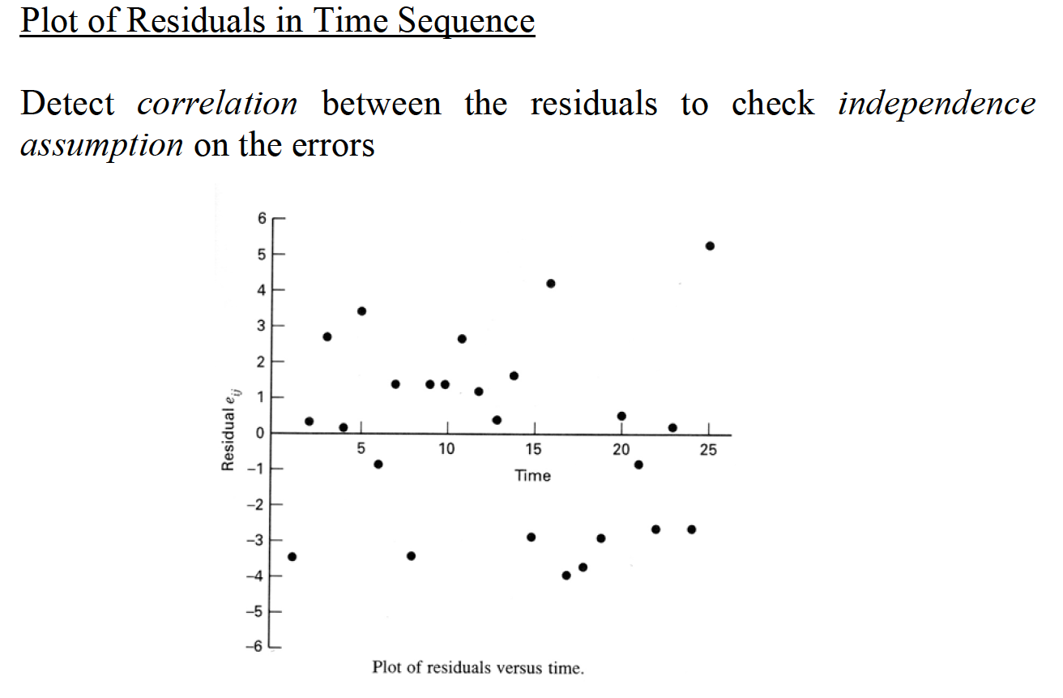
ONE-FACTOR ANALYSIS OF VARIANCE

Slide 33
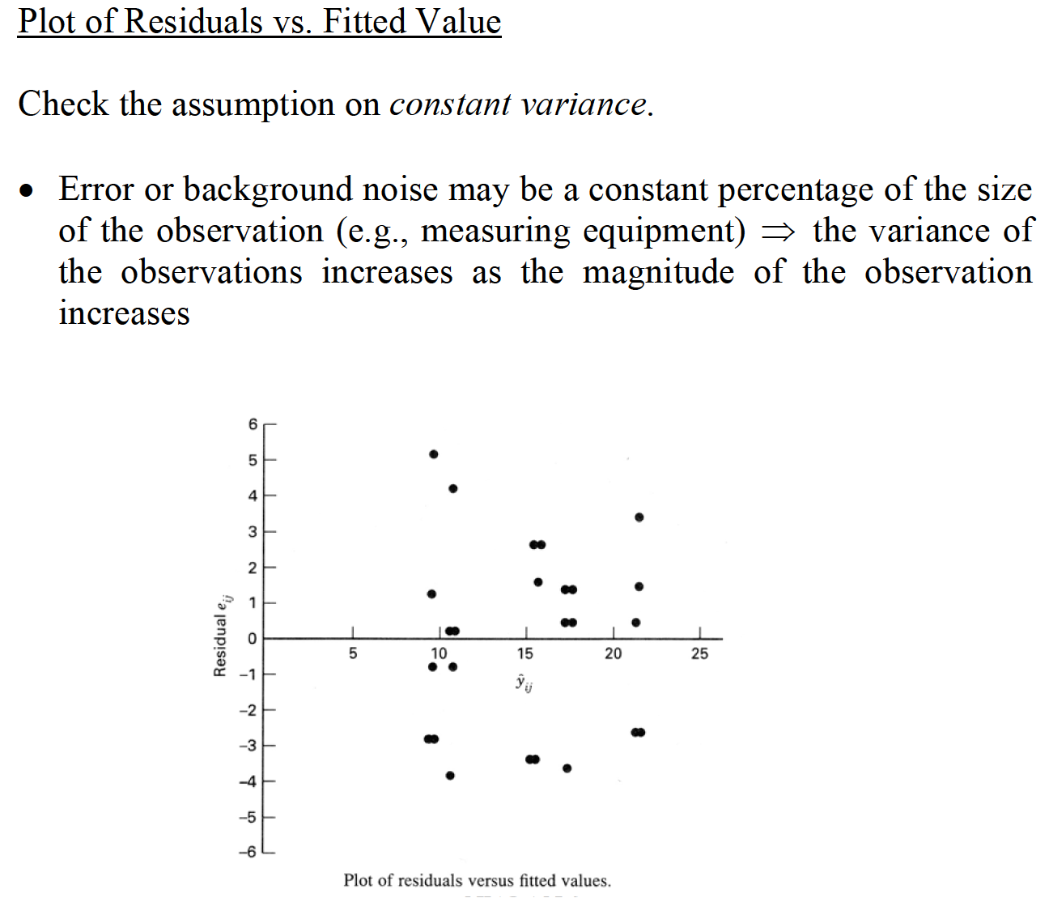
ONE-FACTOR ANALYSIS OF VARIANCE

Slide 34
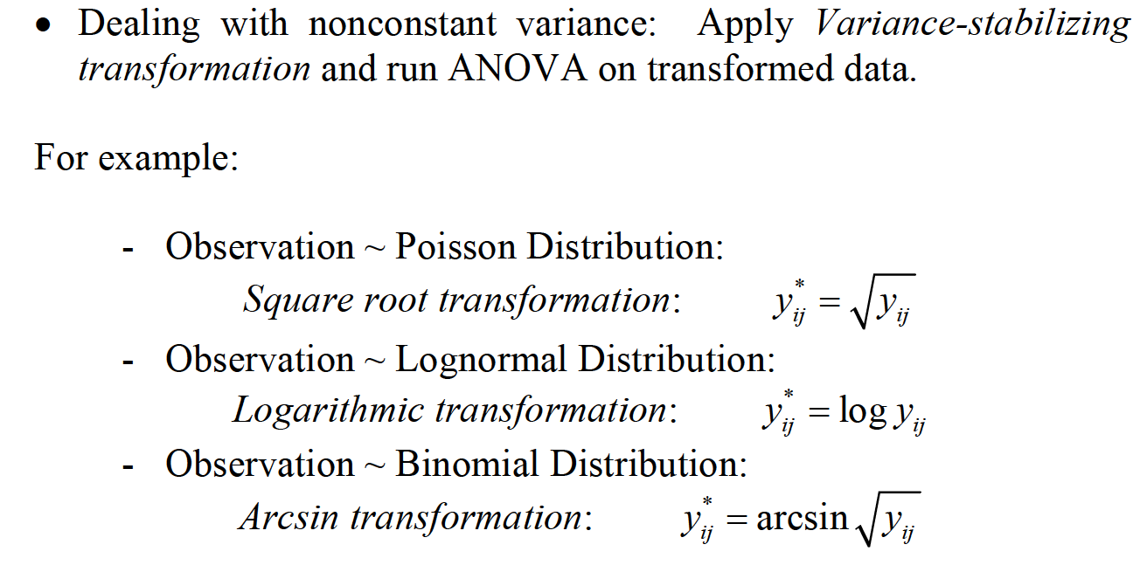
ONE-FACTOR ANALYSIS OF VARIANCE

Slide 35
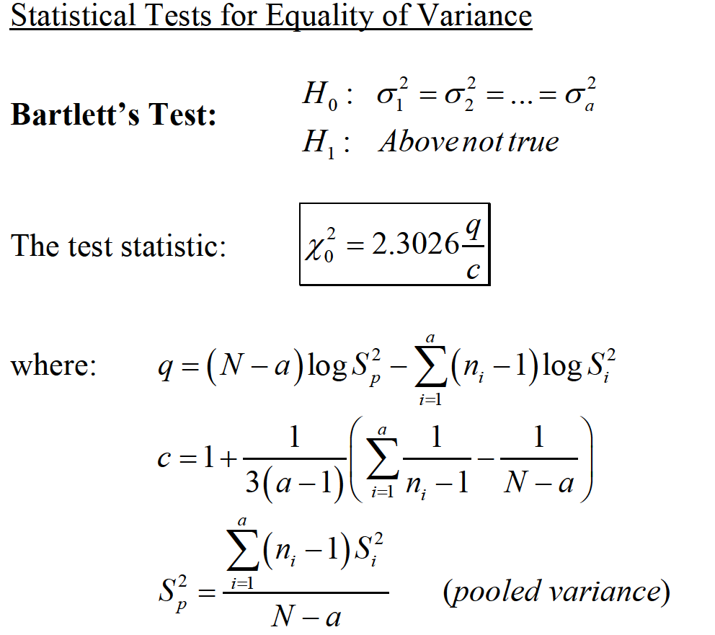
ONE-FACTOR ANALYSIS OF VARIANCE

Slide 36
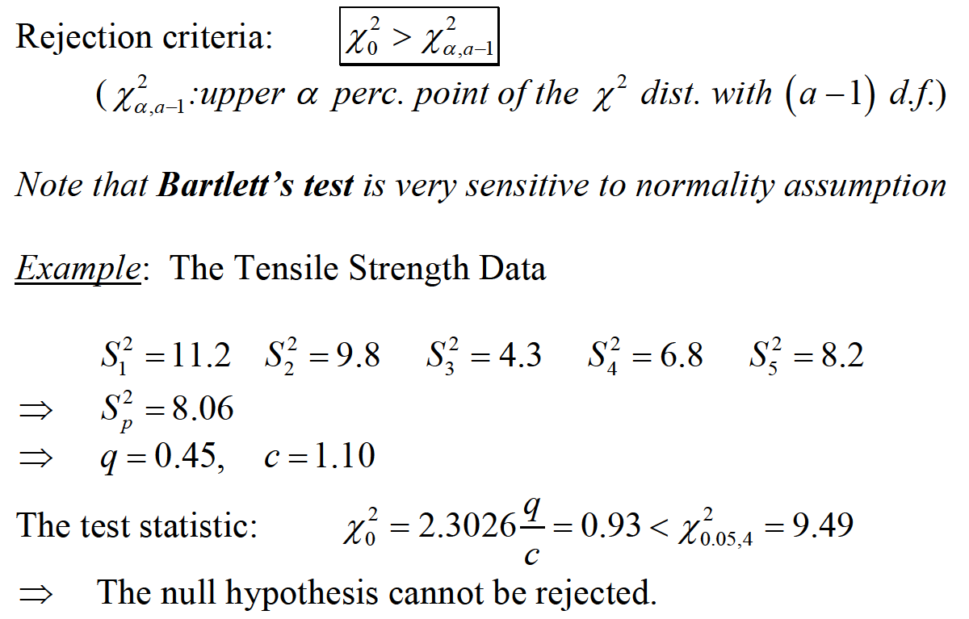
ONE-FACTOR ANALYSIS OF VARIANCE

Slide 37
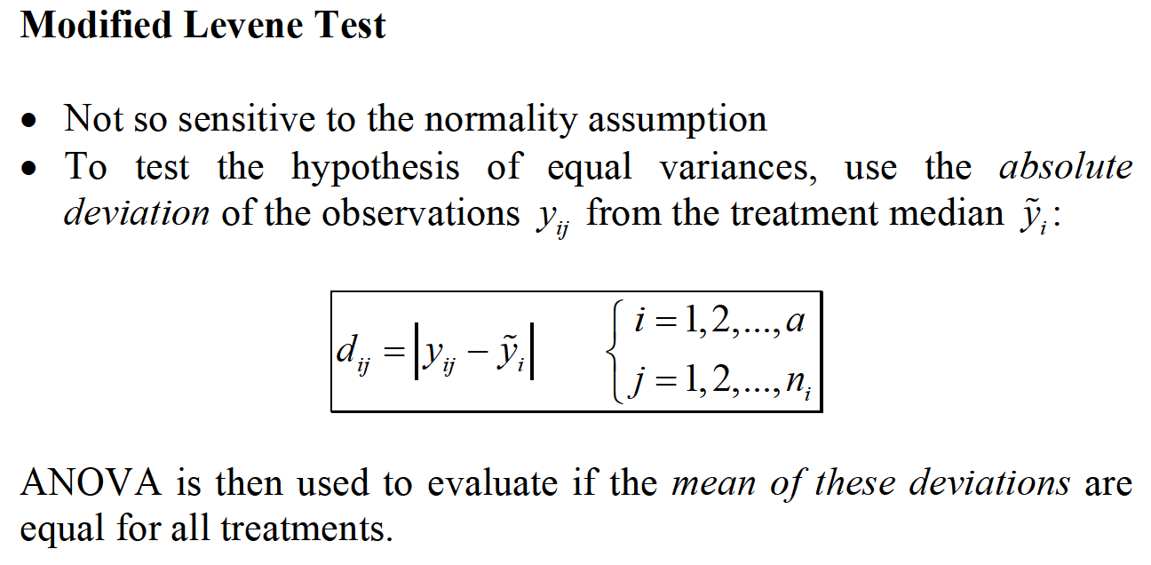
ONE-FACTOR ANALYSIS OF VARIANCE

Slide 38
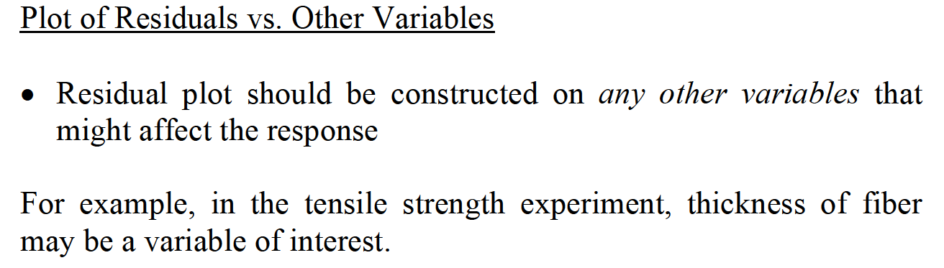
ONE-FACTOR ANALYSIS OF VARIANCE

Slide 39
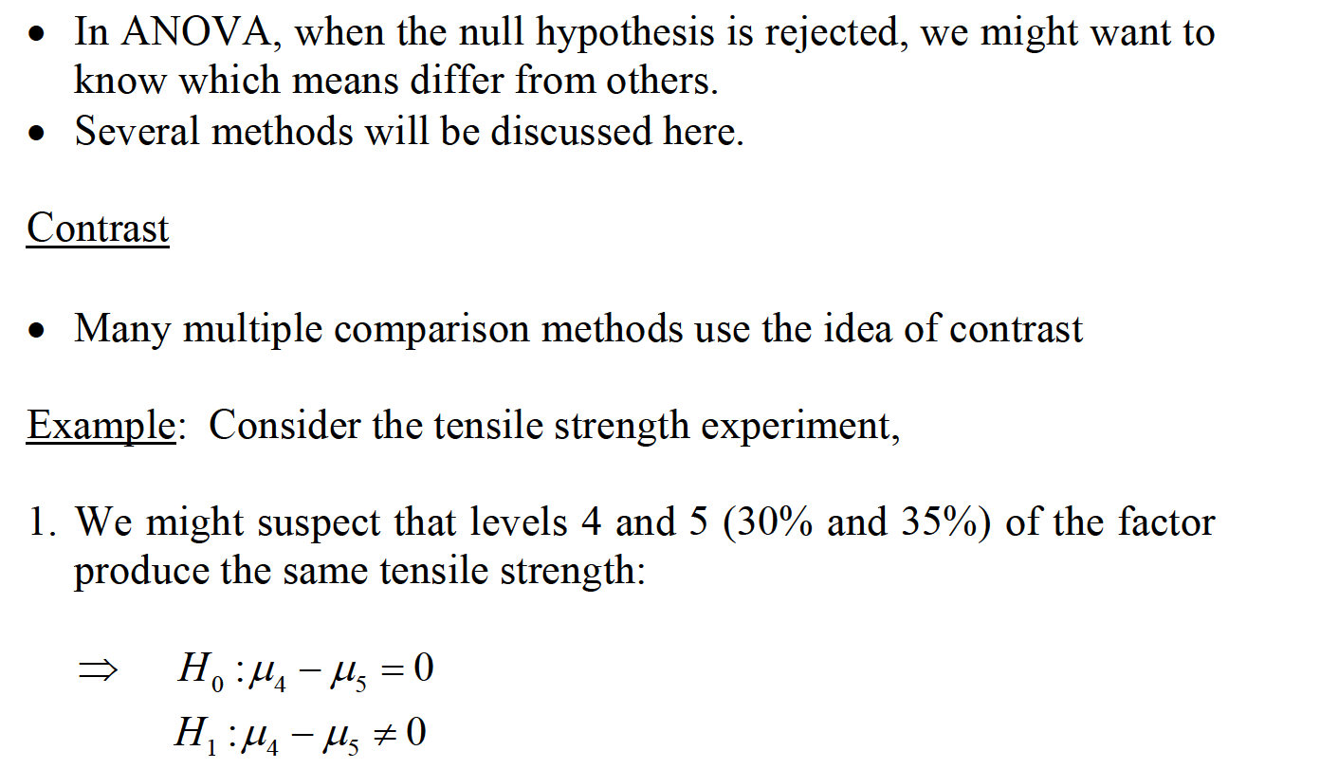
MULTIPLE COMPARISON METHODS

Slide 40
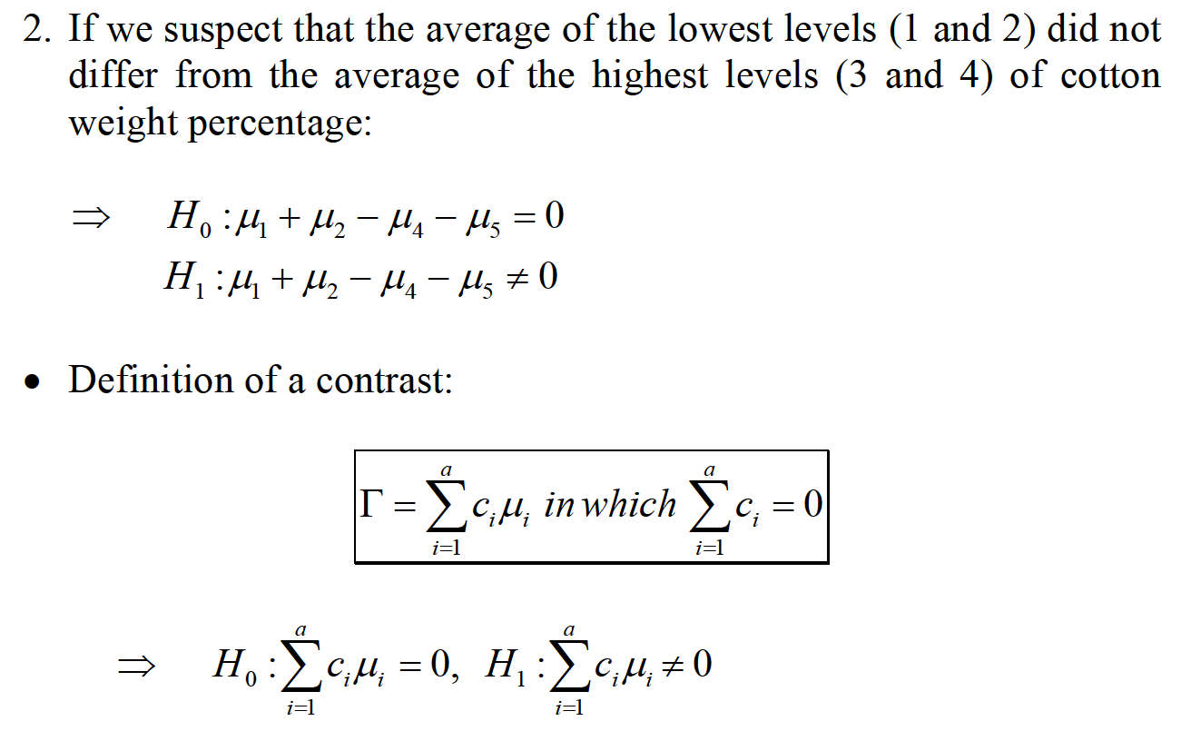
MULTIPLE COMPARISON METHODS

Slide 41
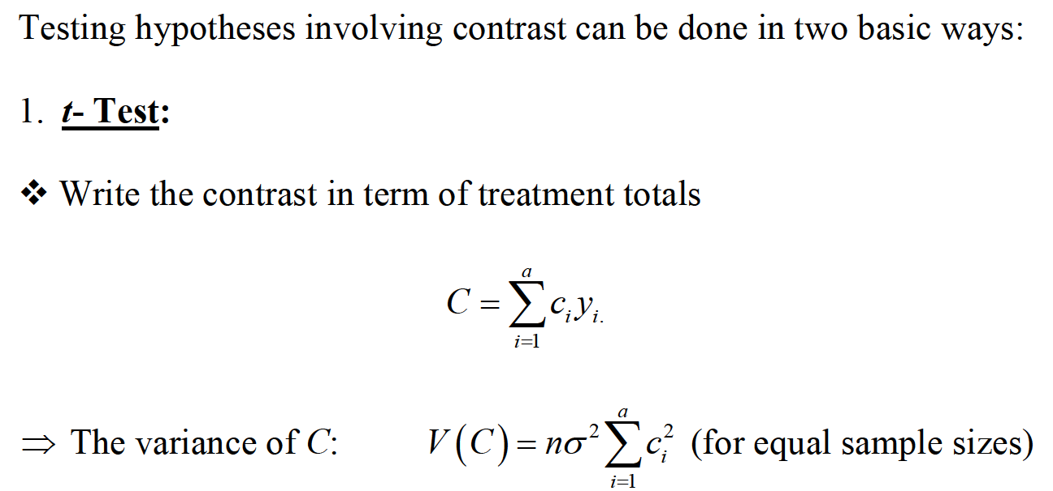
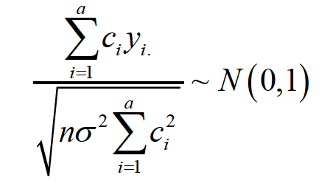
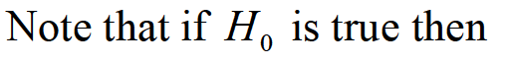
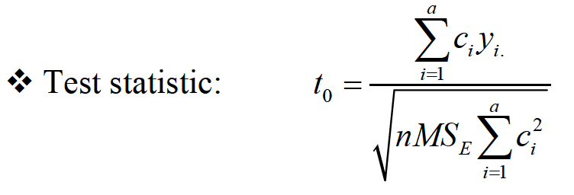
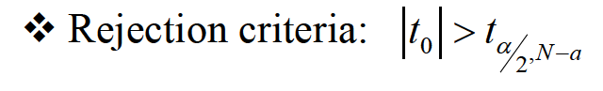
MULTIPLE COMPARISON METHODS

Slide 42
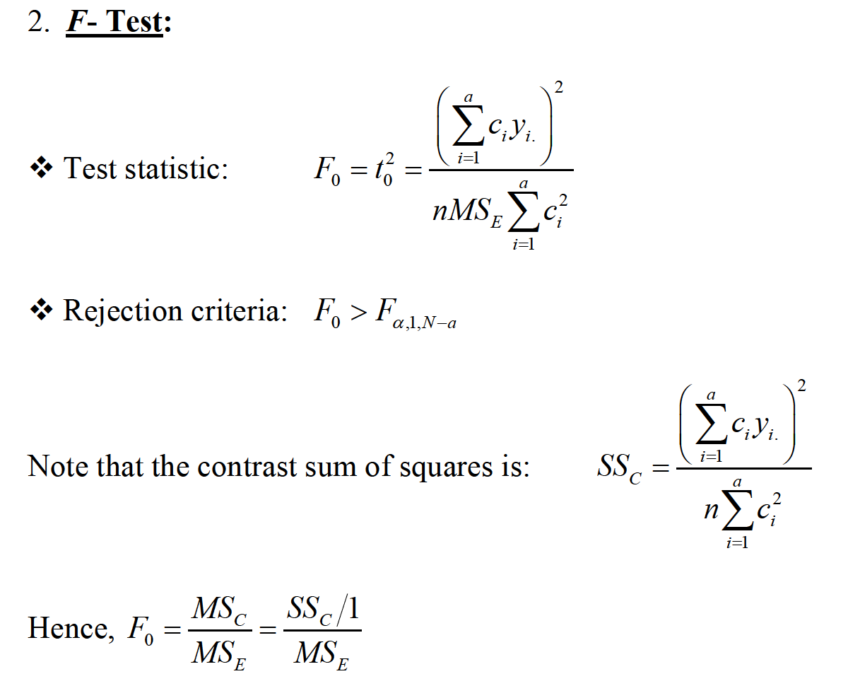
MULTIPLE COMPARISON METHODS

Slide 43
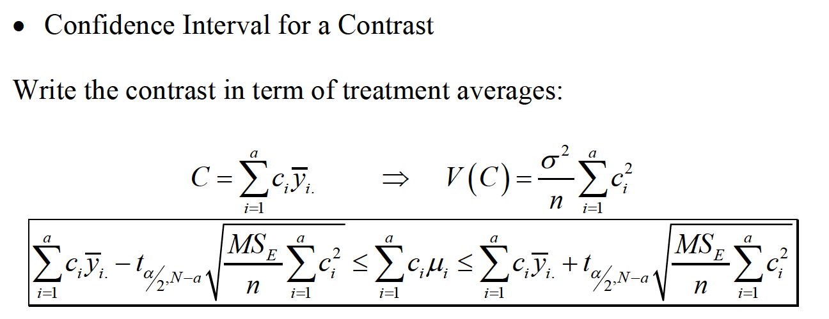
MULTIPLE COMPARISON METHODS

Slide 44

MULTIPLE COMPARISON METHODS

Slide 45

MULTIPLE COMPARISON METHODS

Slide 46




MULTIPLE COMPARISON METHODS

Slide 47

MULTIPLE COMPARISON METHODS

Slide 48

MULTIPLE COMPARISON METHODS

Slide 49

MULTIPLE COMPARISON METHODS

Slide 50

MULTIPLE COMPARISON METHODS

Slide 51

MULTIPLE COMPARISON METHODS

Slide 52

MULTIPLE COMPARISON METHODS

Slide 53


PAIRWISE COMPARISON

Slide 54

PAIRWISE COMPARISON

Slide 55

PAIRWISE COMPARISON

Slide 56


PAIRWISE COMPARISON

Slide 57

PAIRWISE COMPARISON

Slide 58



PAIRWISE COMPARISON

Slide 59


PAIRWISE COMPARISON

Slide 60

PAIRWISE COMPARISON

Slide 61


REGRESSION APPROACH TO ANOVA

Slide 62

REGRESSION APPROACH TO ANOVA

Slide 63

REGRESSION APPROACH TO ANOVA

Slide 64

REGRESSION APPROACH TO ANOVA

Slide 65

REGRESSION APPROACH TO ANOVA

Slide 66


REGRESSION APPROACH TO ANOVA

Slide 67

REGRESSION APPROACH TO ANOVA

Slide 68

REGRESSION APPROACH TO ANOVA

Slide 69

NONPARAMETRIC METHODS IN ANOVA

Slide 70

NONPARAMETRIC METHODS IN ANOVA

Slide 71

ONE-FACTOR ANALYSIS OF VARIANCE

Slide 72

NONPARAMETRIC METHODS IN ANOVA

Slide 73

TWO-WAY ANOVA - THE RANDOMIZED COMPLETE BLOCK DESIGN

Slide 74


TWO-WAY ANOVA - THE RANDOMIZED COMPLETE BLOCK DESIGN

Slide 75

TWO-WAY ANOVA - THE RANDOMIZED COMPLETE BLOCK DESIGN

Slide 76

TWO-WAY ANOVA - THE RANDOMIZED COMPLETE BLOCK DESIGN

Slide 77

TWO-WAY ANOVA - THE RANDOMIZED COMPLETE BLOCK DESIGN

Slide 78

TWO-WAY ANOVA - THE RANDOMIZED COMPLETE BLOCK DESIGN

Slide 79


TWO-WAY ANOVA - THE RANDOMIZED COMPLETE BLOCK DESIGN

Slide 80

TWO-WAY ANOVA - THE RANDOMIZED COMPLETE BLOCK DESIGN

Slide 81

TWO-WAY ANOVA - THE RANDOMIZED COMPLETE BLOCK DESIGN

Slide 82


TWO-WAY ANOVA - THE RANDOMIZED COMPLETE BLOCK DESIGN

Slide 83

TWO-WAY ANOVA - THE RANDOMIZED COMPLETE BLOCK DESIGN

Slide 84

TWO-WAY ANOVA - THE RANDOMIZED COMPLETE BLOCK DESIGN

Slide 85

TWO-WAY ANOVA - THE RANDOMIZED COMPLETE BLOCK DESIGN

Slide 86

TWO-WAY ANOVA - THE RANDOMIZED COMPLETE BLOCK DESIGN

Slide 87

TWO-WAY ANOVA - THE RANDOMIZED COMPLETE BLOCK DESIGN

Slide 88

TWO-WAY ANOVA - THE RANDOMIZED COMPLETE BLOCK DESIGN

Slide 89

TWO-WAY ANOVA - THE RANDOMIZED COMPLETE BLOCK DESIGN

Slide 90

TWO-WAY ANOVA - THE RANDOMIZED COMPLETE BLOCK DESIGN

Slide 91





TWO-WAY ANOVA - THE RANDOMIZED COMPLETE BLOCK DESIGN

Slide 92

ESTIMATE MISSING VALUE

Slide 93


ESTIMATE MISSING VALUE

Slide 94

ESTIMATE MISSING VALUE

Slide 95

ESTIMATE MISSING VALUE

Slide 96

ESTIMATE MISSING VALUE

Slide 97

ESTIMATE MISSING VALUE

Slide 98


GENERAL REGRESSION SIGNIFICANT TEST

Slide 99

GENERAL REGRESSION SIGNIFICANT TEST

Slide 100

GENERAL REGRESSION SIGNIFICANT TEST

Slide 101

GENERAL REGRESSION SIGNIFICANT TEST

Slide 102

GENERAL REGRESSION SIGNIFICANT TEST

Slide 103



GENERAL REGRESSION SIGNIFICANT TEST

Slide 104

GENERAL REGRESSION SIGNIFICANT TEST

Slide 105

GENERAL REGRESSION SIGNIFICANT TEST

